Slide 1
Introduction to Sensors & Actuators

Slide 2
Basic Principle of Sensor
Measuring
Parameter
Useful Signal
Conversion Device
Displacement, Temperature, Pressure etc….
Voltage, current, capacitance
Sensor is a device that when exposed to a physical phenomenon (temperature, displacement, force, etc.) produces a proportional output signal (electrical, mechanical, magnetic, etc.).

Slide 3
Sensors
Stimulus (s)
Signal (S)
Physical
Medium
Sensing
Element
Conditioning
Target
Handling
Temperature
Resistance
Voltage
Information
Transducers
Micro-sensors 10⁻⁶m

Slide 4
Transfer Function
where S = output signal; s = stimulus; and f(s) = functional relationship
For binary sensors: S = 1 if s > 0 and S = 0 if s < 0.
The ideal functional form for an analogue measuring device is a simple proportional relationship, such as:
where C = output value at a stimulus value of zero
and m = constant of proportionality (sensitivity)

Slide 5

Human beings are equipped with 5 different types of sensors.

Slide 6
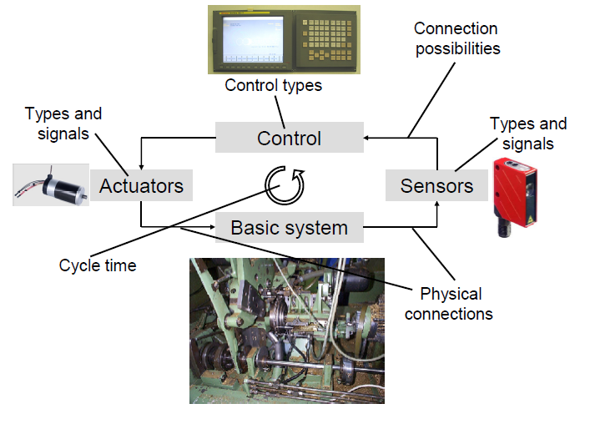
System Overview

Slide 7
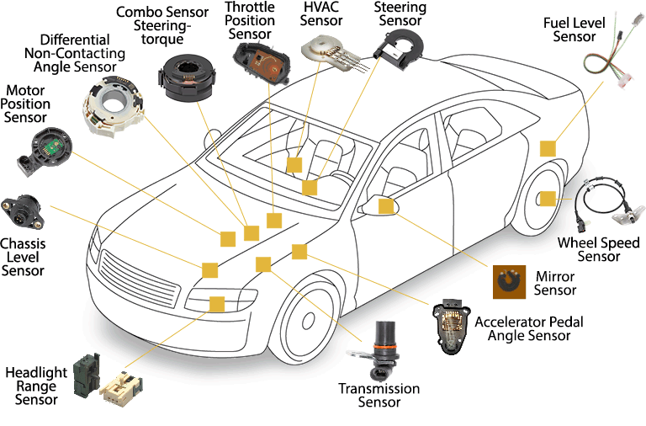

Slide 8
Transducer
A device which converts one form of energy to another
When input is a physical quantity and output electrical → Sensor
When input is electrical and output a physical quantity → Actuator
Sensors
Actuators
e.g. Piezoelectric:
Force -> voltage
Voltage-> Force
Physical parameter
Electrical Input
Electrical Output
Physical Output

Slide 9
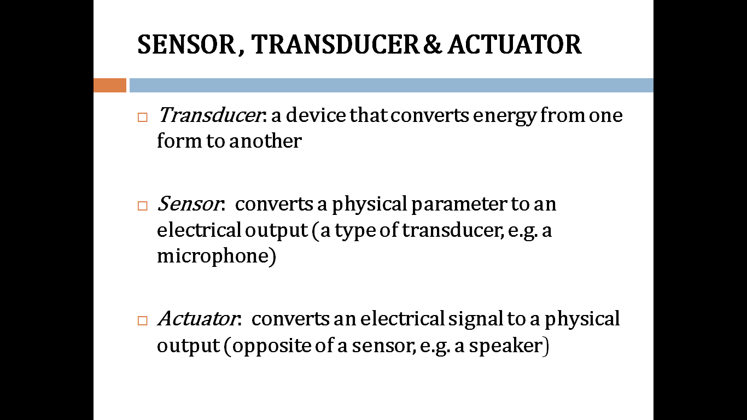

Slide 10
1.Position Sensors
Position Sensors
Potentio-meter
Encoders
LVDT

Slide 11
Potentiometer
A three-terminal resistor with a sliding contact that forms an adjustable voltage divider
Used to convert rotary or linear displacement to a voltage
Resistance value can also be converted to a voltage
Used to detect angular position (i.e. of a robot arm, etc.)

Slide 12
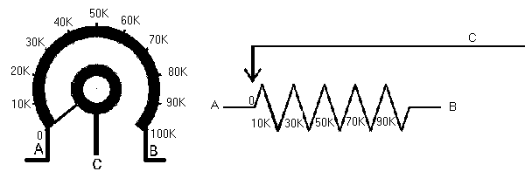
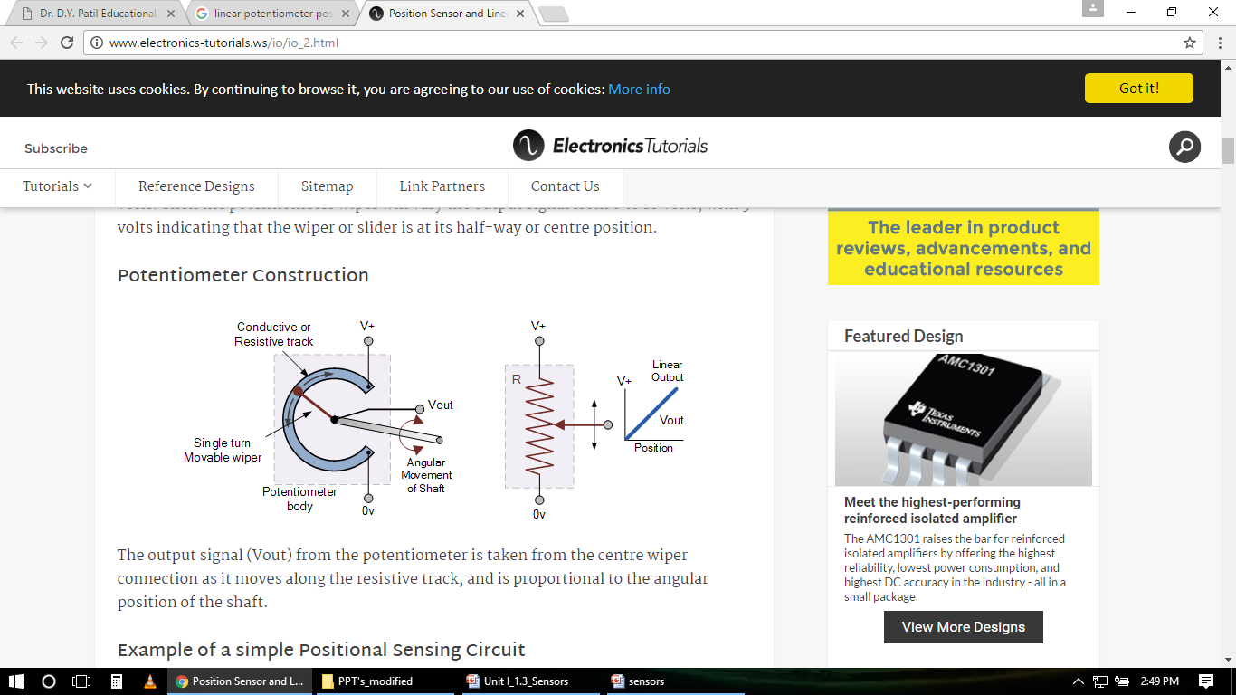
Potentiometer
Rotary potentiometer
Linear potentiometer
A rotary and linear potentiometer is a variable resistance device that can be used to measure angular position and linear position.
Through voltage division the change in resistance can be used to create an output voltage that is directly proportional to the input displacement.
Fig. Rotary potentiometer
Fig. Linear potentiometer

Slide 13
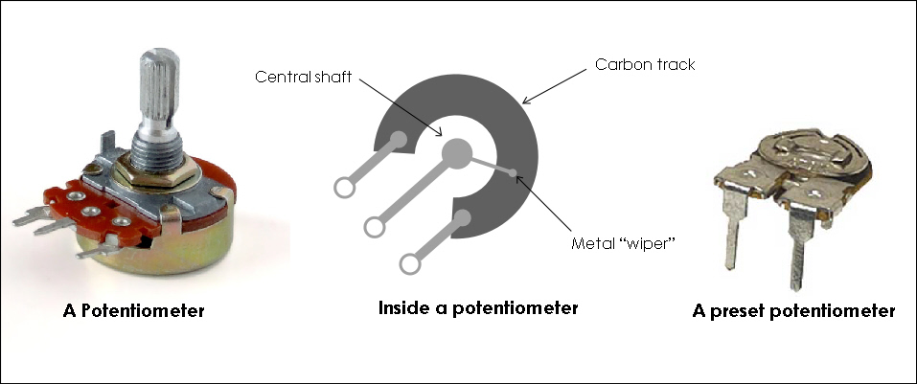
Rotary Potentiometer
Resistive material has a uniform resistivity so that the ohms-per-inch value along its length is constant.

Slide 14
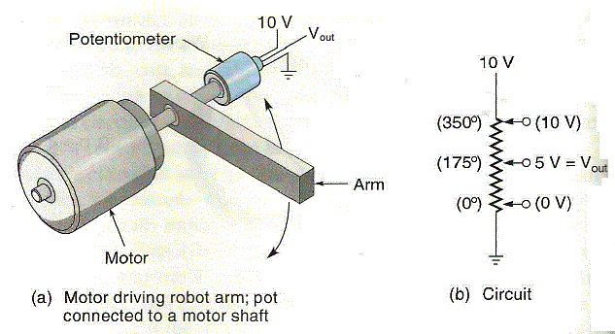
Eg-
The wiper can be used to control the voltage along an element.
The wiper taps off the voltage drop between its contact point and ground

Slide 15
Advantages of the potentiometer are:
Easy to use
Low cost
High amplitude output
Easily available
Can be used for measuring even large displacements.
Can produce a high electrical efficiency
Disadvantages
Since the wiper is sliding across the resistive element there is a possibility of friction and wear. Hence the number of operating cycles are limited.

Slide 16
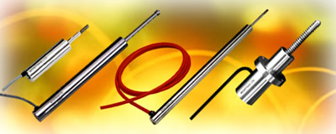
Linear Variable Differential Transformer
‘LVDT’ is a transducer for measuring linear displacement
It must be excited by an AC signal to induce AC response on secondary.
The core position can be determined by measuring secondary response.

Slide 17
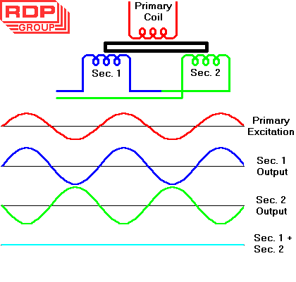
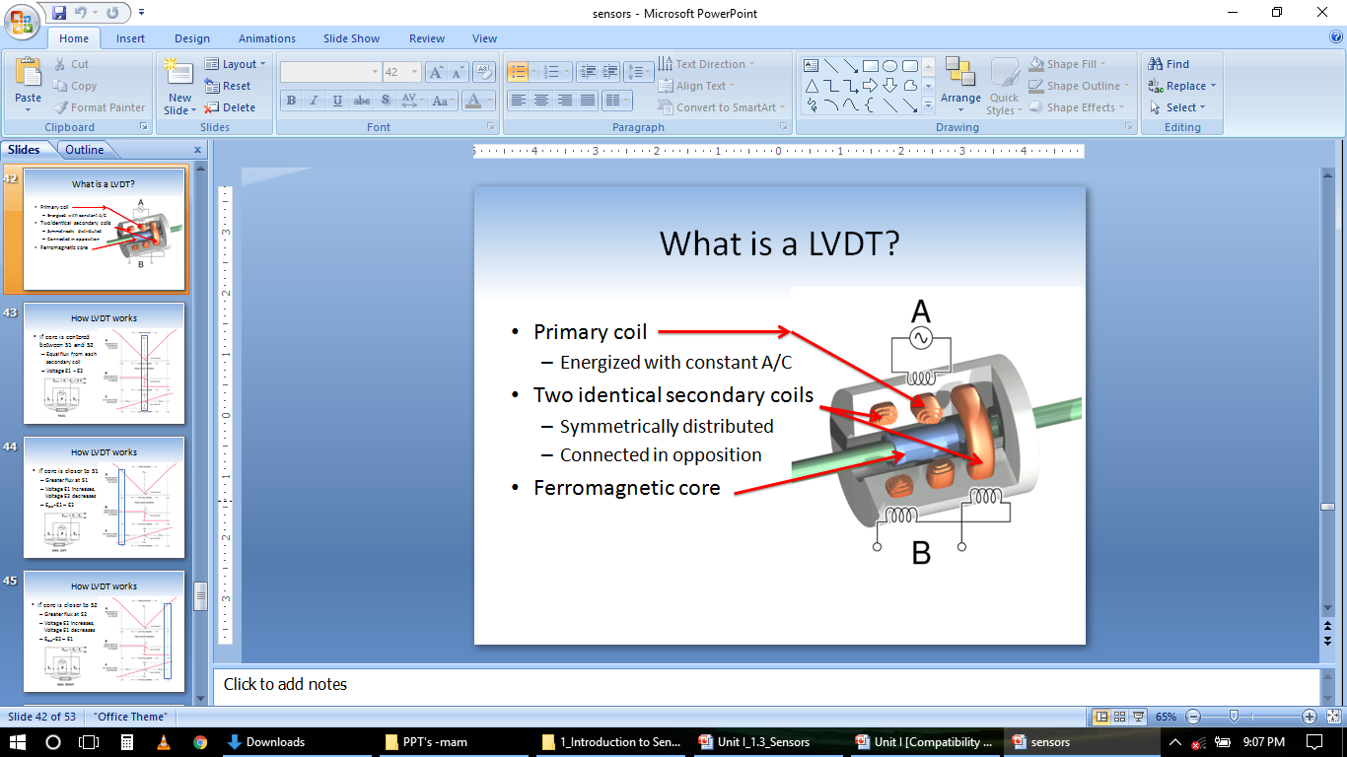
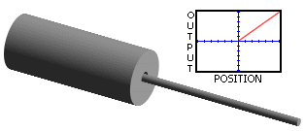
LVDT

Slide 18
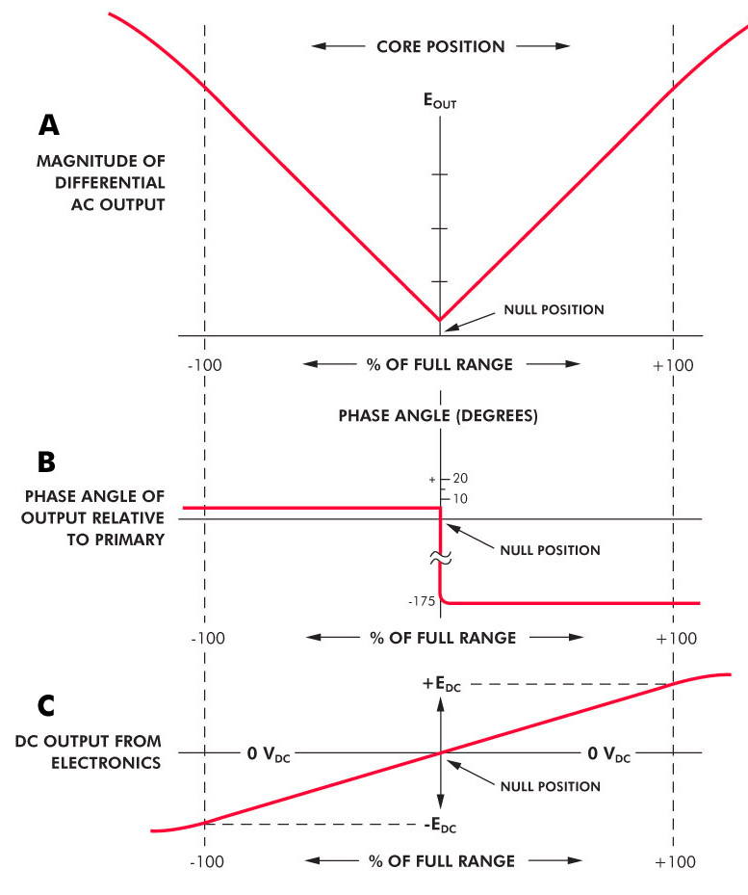
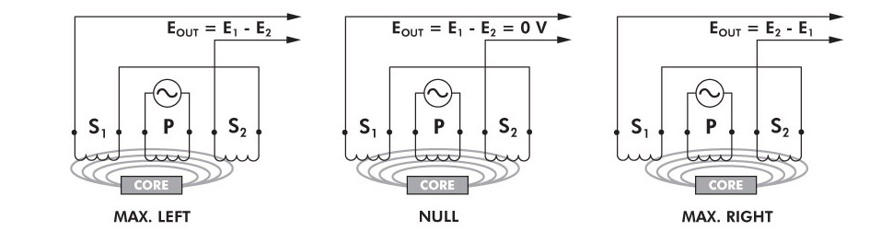
How LVDT works?
1.If core is centered between S1 and S2
Equal flux from each secondary coil
Voltage E1 = E2

Slide 19
2.If core is closer to S1
Greater flux at S1
Voltage E1 increases, Voltage E2 decreases
E_{out}=E1 – E2

Slide 20
3. If core is closer to S2
Greater flux at S2
Voltage E2 increases, Voltage E1 decreases
E_{out}=E2 – E1

Slide 21
Advantages of LVDT-
High Range - The LVDTs have a very high range for measurement of displacement. they can used for measurement of displacements ranging from 0.25 mm to 250 mm
No Frictional Losses - As the core moves inside a hollow former so there is no loss of displacement input as frictional loss so it makes LVDT as very accurate device.
High Input and High Sensitivity - The output of LVDT is so high that it doesn’t need any amplification. The transducer possesses a high sensitivity which is typically about 40V/mm.
Low Hysteresis - LVDTs show a low hysteresis and hence repeatability is excellent under all conditions
Low Power Consumption - The power is about 1W which is very as compared to other transducers.
Direct Conversion to Electrical Signals - They convert the linear displacement to electrical voltage which are easy

Slide 22
Disadvantages of LVDT-
LVDT is sensitive to stray magnetic fields so they always require a setup to protect them from stray magnetic fields.
They are affected by vibrations and temperature.
Applications of LVDT-
They are used in applications where displacements ranging from fraction of mm to few cm are to be measured.
The LVDT acting as a primary transducer converts the displacement to electrical signal directly.
They can also acts as the secondary transducers.
E.g. the Bourbon tube which acts as a primary transducer and covert pressure into linear displacement. Then LVDT coverts this displacement into electrical signal which after calibration gives the ideas of the pressure of fluid.

Slide 23
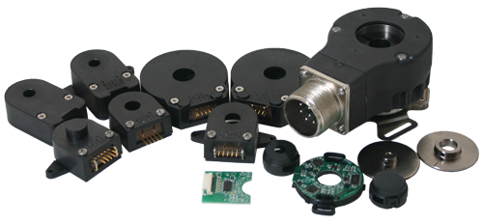
Encoders
Digital Optical Encoders types
Absolute Digital Optical Encoders
Incremental Digital Optical Encoders

Slide 24
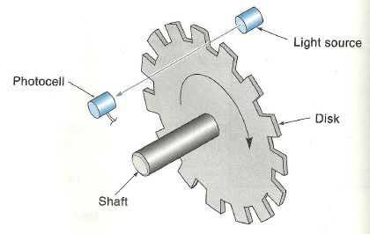
Digital Optical Encoders
Produces angular position data directly in digital form, eliminating any need for ADC
The design is comprised of a “code disk” attached to a shaft
A light source and photocell arrangement are mounted so that the slots pass the light beam as the disk rotates
The angle of the shaft is deduced from the output of the photocell

Slide 25
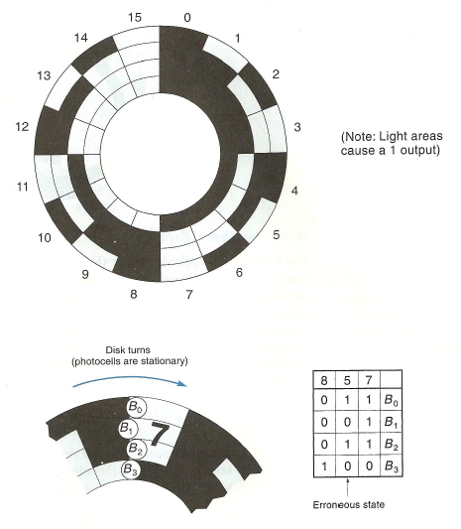
Absolute Encoder

Slide 26
Absolute Encoder
Uses a glass disk marked off with a pattern of concentric tracks
A separate light beam is sent through each track to individual photo-sensors
Each photo-sensor contributes 1 bit to the output digital word
Advantage of this encoder is that the output is in straightforward digital form

Slide 27
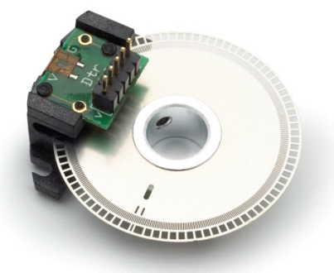
Incremental Encoder
Has only one track of equally spaced slots
Position is determined by counting the number of slots that pass a photo-sensor, where each slot represents a known angle
Requires an initial reference point, which may come from a second sensor
To track position, the controller must know the direction the disk is turning as well as the number of slots passed

Slide 28
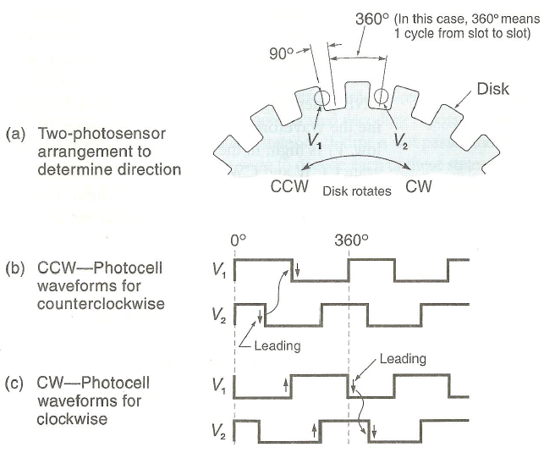
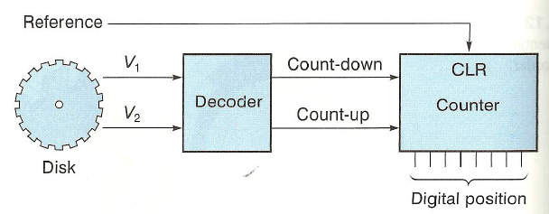

Slide 29
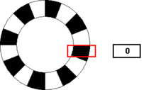
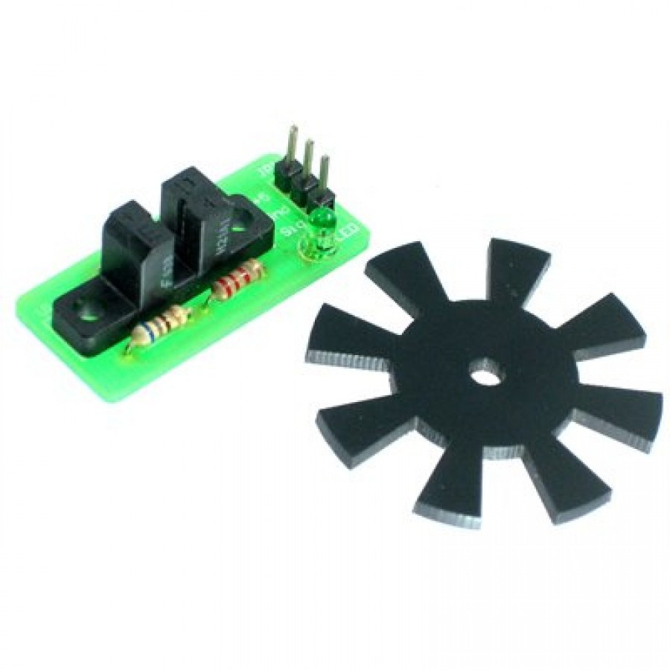
Simple Rotary Encoder

Slide 30
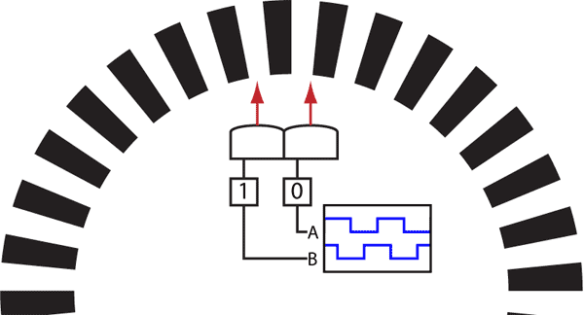
Quadrature Encoder

Slide 31
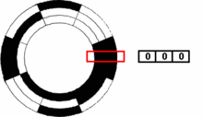
Binary Encoder

Slide 32
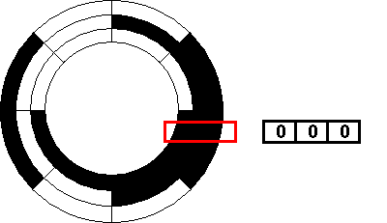
Grey Code Encoder

Slide 33
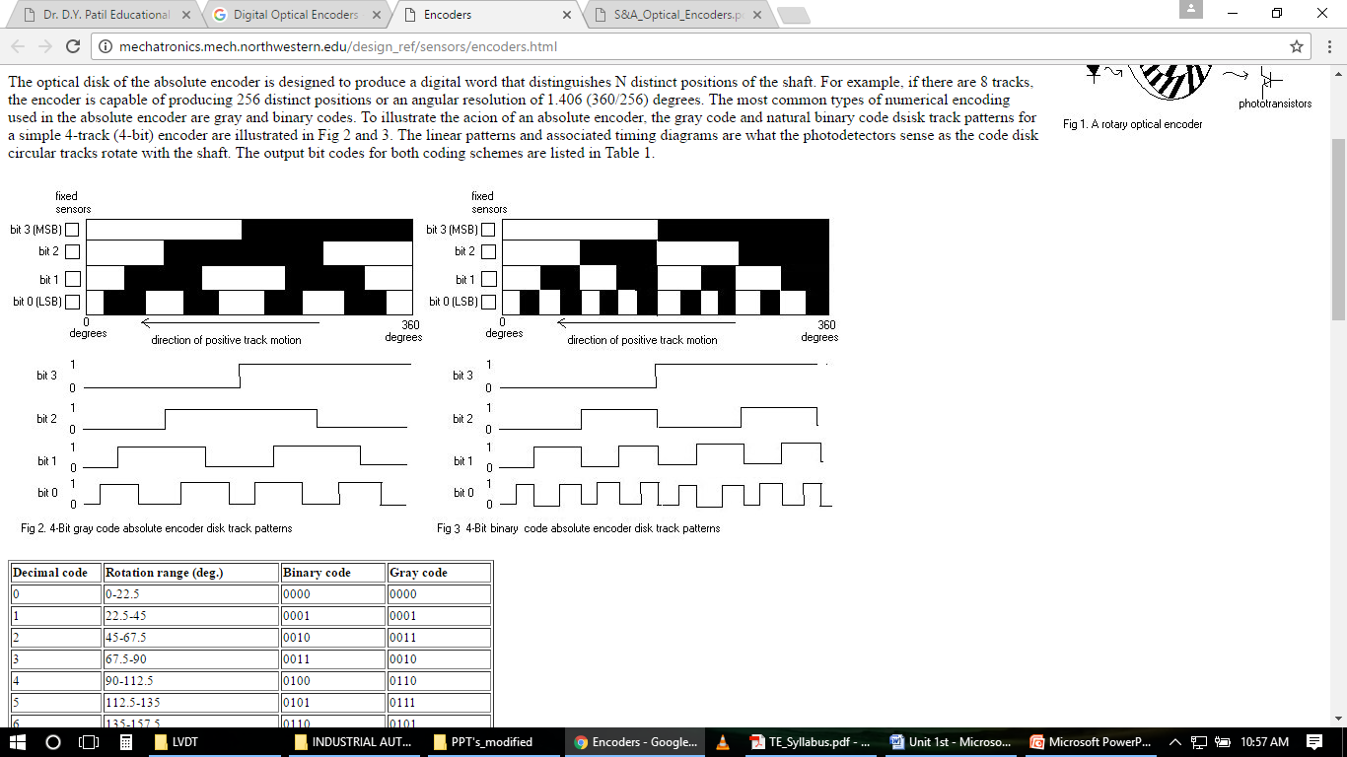

Slide 34
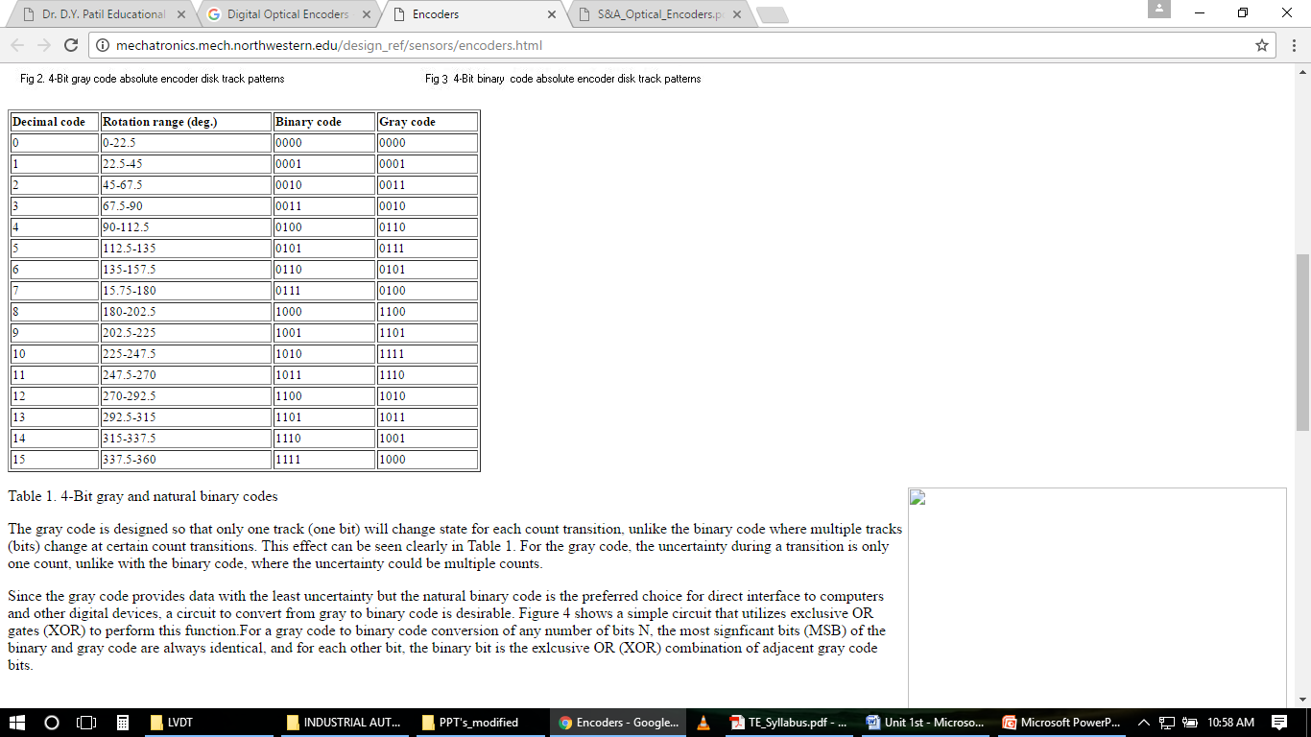

Slide 35
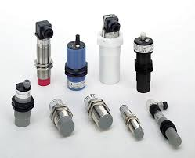
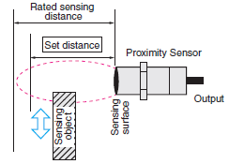
Proximity sensors
Proximity sensors types:
Optical
Inductive
Capacitive

Slide 36
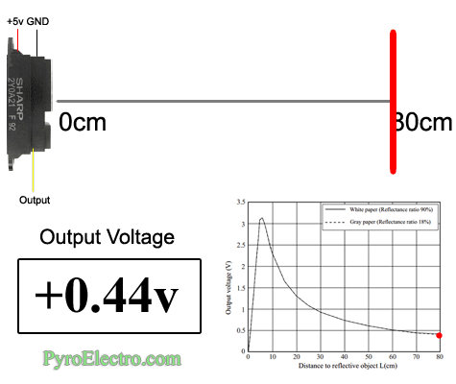
Proximity sensors

Slide 37
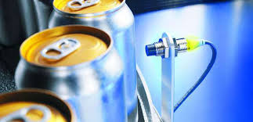
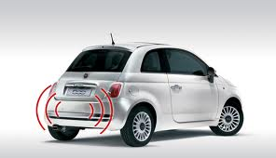
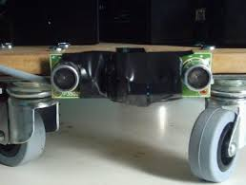
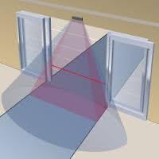
Application of Proximity sensors

Slide 38
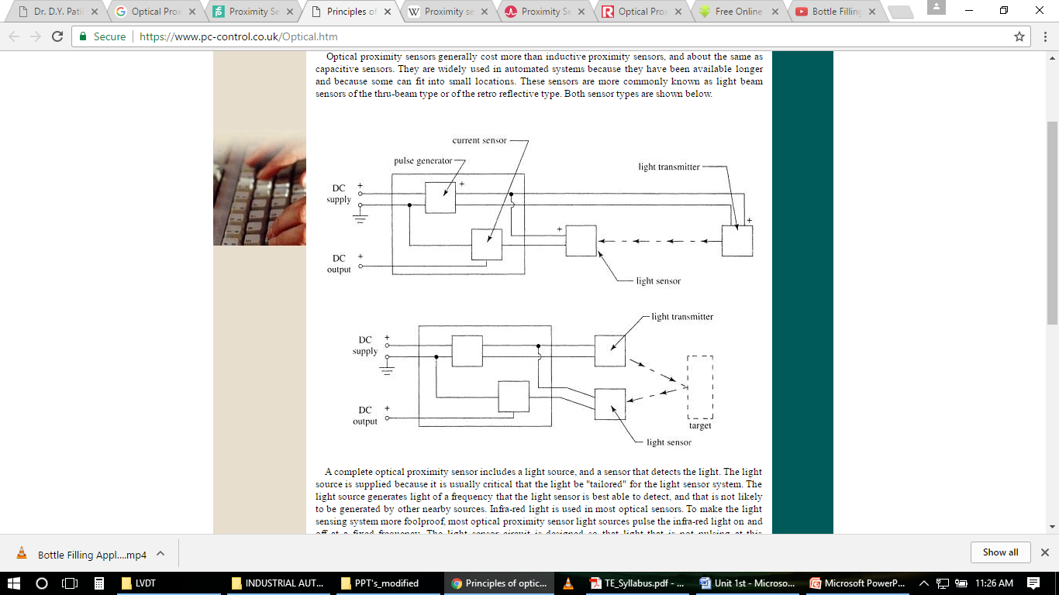
Optical Proximity Sensors

Slide 39
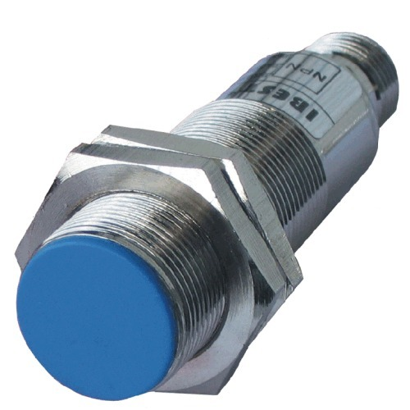
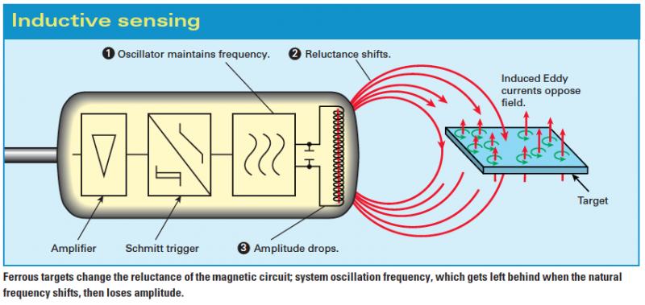
Inductive Proximity sensors
The coil generates a magnetic field that extends out
the face of the sensor.
If a metal object moves into the field, change the reluctance of magnetic circuit system oscillation frequency, eddy currents are induced in the object, causing the magnitude of the coil oscillations to be reduced.

Slide 40
Inductive Proximity sensors
A sturdy self-contained device that can detect the presence of all metals at relatively close range (under an inch)
Advantages
They are very accurate compared to other technologies.
Have high switching rate.
Can work in harsh environmental conditions.
Disadvantages
It can detect only metallic target.
Operating range may be limited.

Slide 41
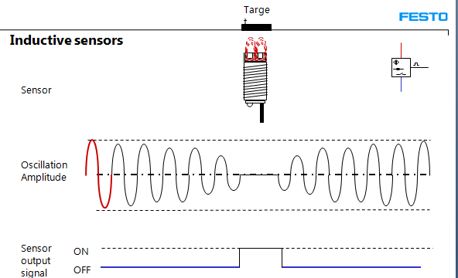

Slide 42
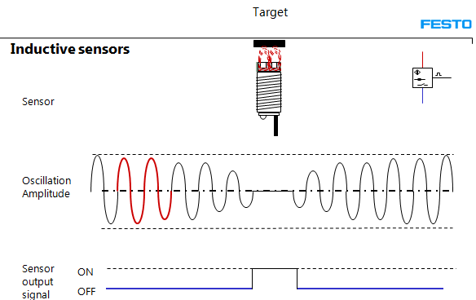

Slide 43
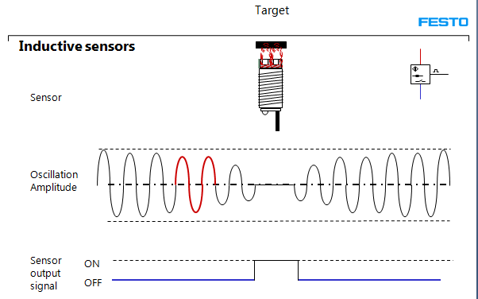

Slide 44
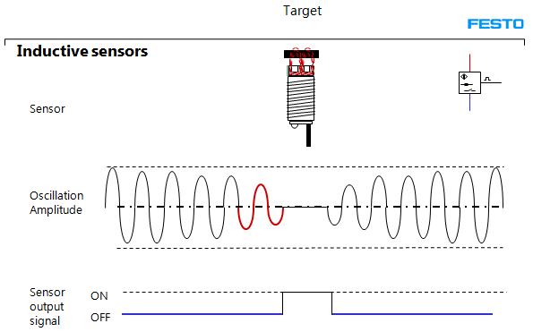

Slide 45
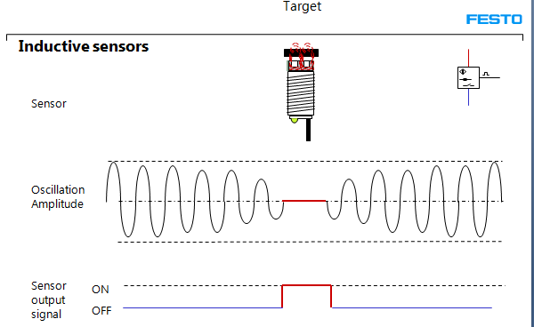

Slide 46
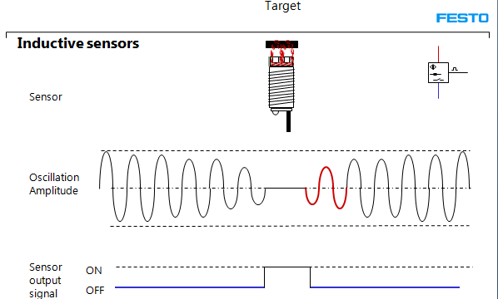

Slide 47


Slide 48
Capacitive Proximity sensors
The sensing surface of the sensor’s probe is the electrified plate.
The sensor electronics continually changes the voltage on the probe surface
The amount of current required change this voltage is measured which indicates the amount of capacitance distance between the probe and target.
Capacitive sensing is a noncontact technology suitable for detecting metals, nonmetals, solids, and liquids, although it is best suited for nonmetallic targets because of its characteristics and cost relative to inductive proximity sensors. In most applications with metallic targets, inductive sensing is preferred because it is both a reliable and a more affordable technology.

Slide 49
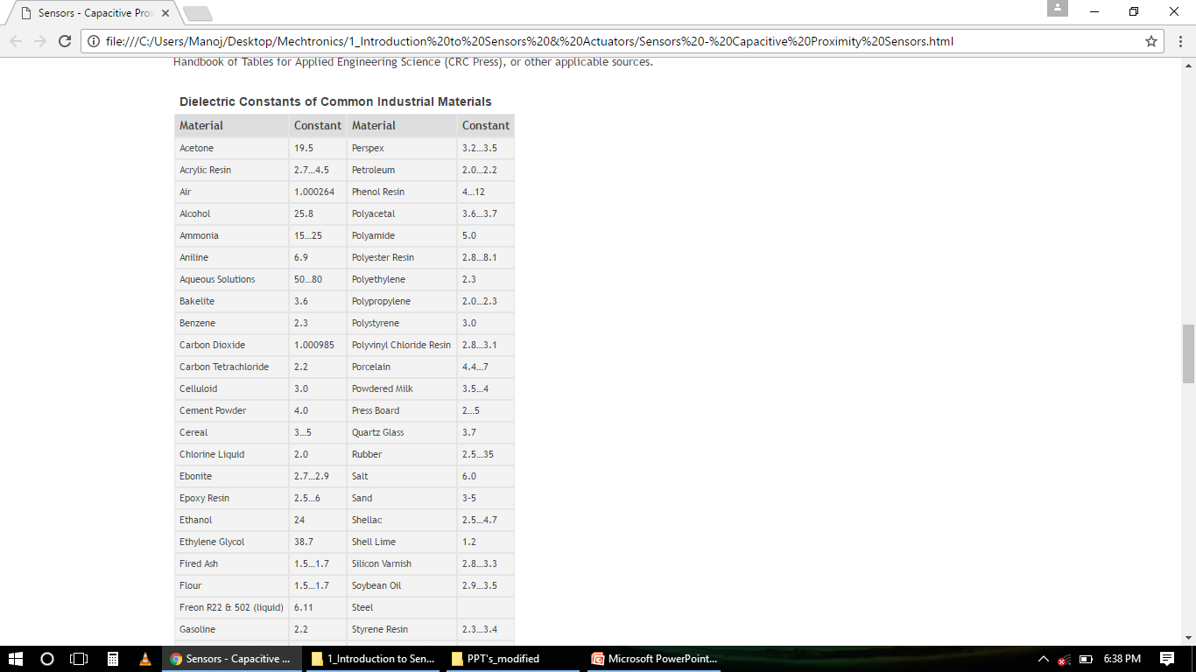
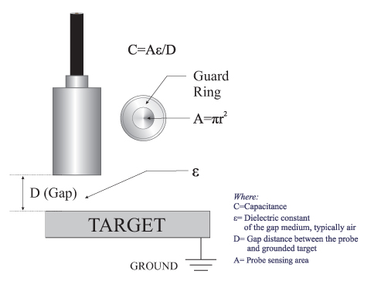
Capacitive Proximity sensors
generate an electrostatic field

Slide 50
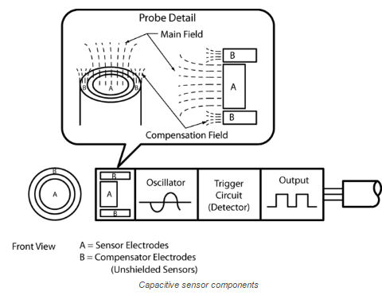

Slide 51
Working-
Capacitive proximity sensors are similar in size, shape, and concept to inductive proximity sensors. However, unlike inductive sensors which use induced magnetic fields to sense objects, capacitive proximity generate an electrostatic field and reacts to changes in capacitance caused when a target enters the electrostatic field.
When the target is outside the electrostatic field, the oscillator is inactive. As the target approaches, a capacitive coupling develops between the target and the capacitive probe.
When the capacitance reaches a specified threshold, the oscillator is activated, triggering the output circuit to switch states between ON and OFF
The ability of the sensor to detect the target is determined by the target’s size, dielectric constant and distance from the sensor.
The larger the target’s size, the stronger the capacitive coupling between the probe and the target.
Materials with higher dielectric constants are easier to detect than those with lower values.
The shorter the distance between target and probe, the stronger the capacitive coupling between the probe and the target.

Slide 52
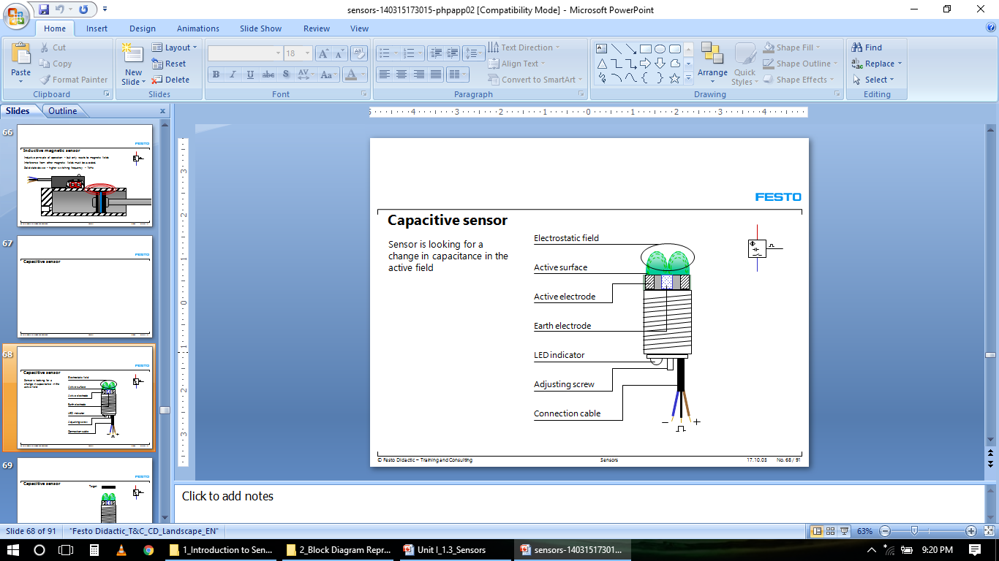

Slide 53
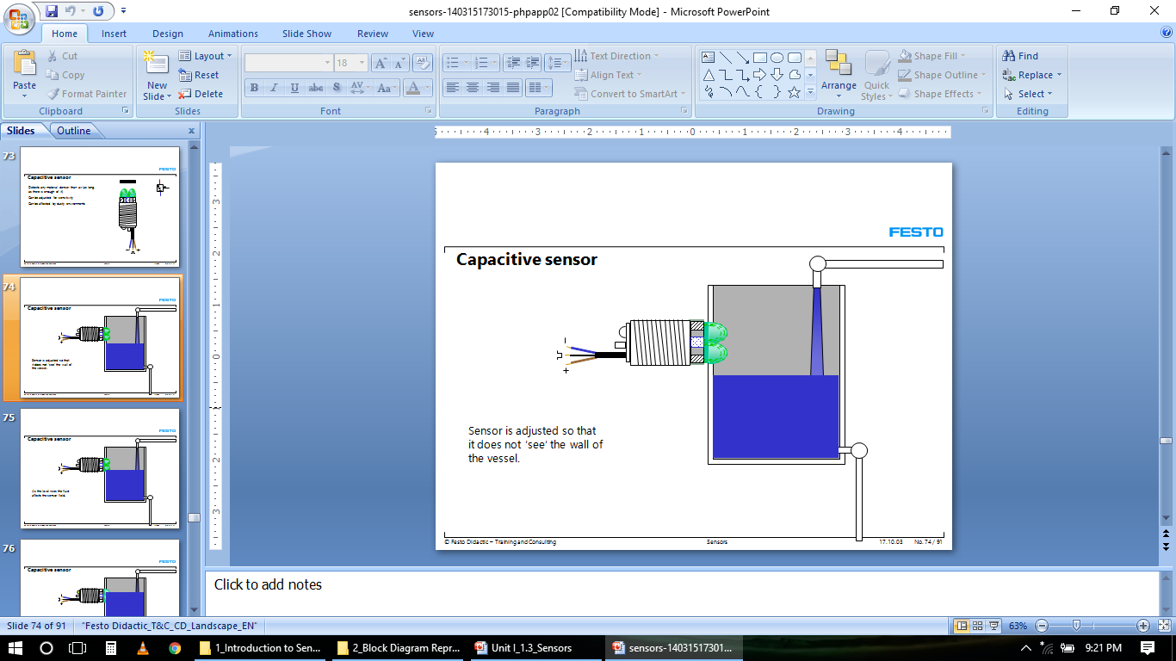

Slide 54
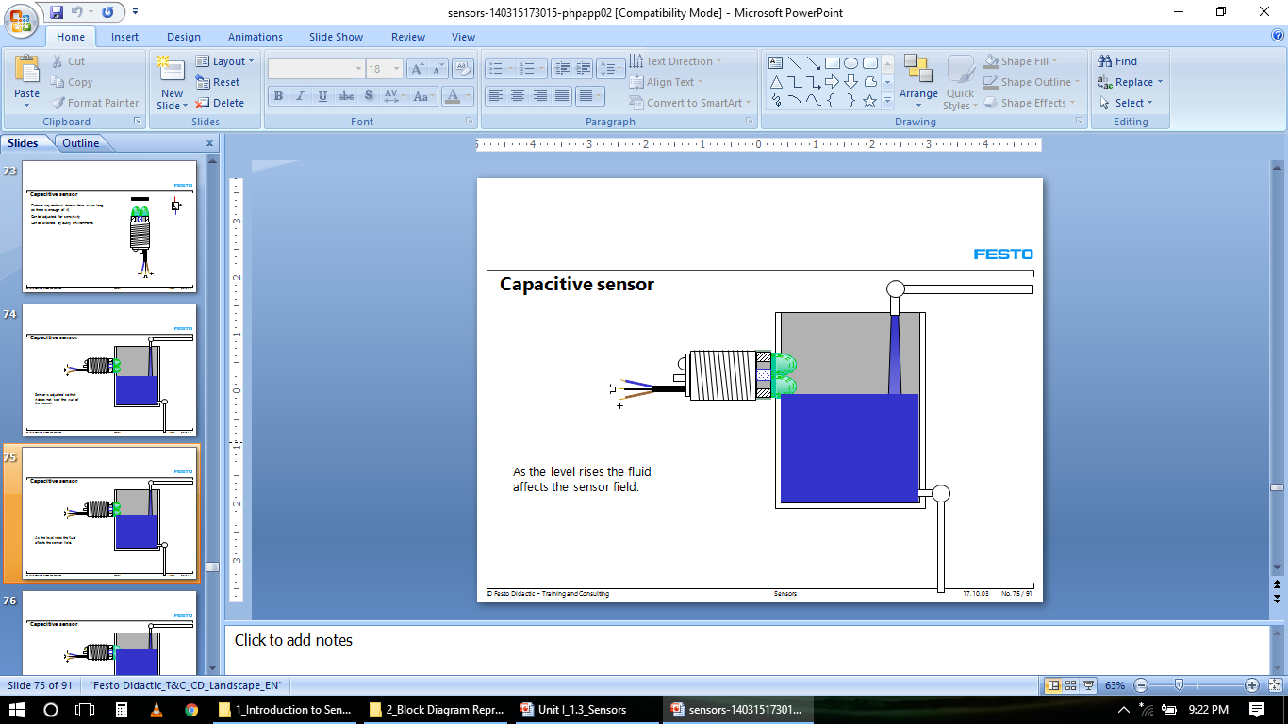

Slide 55
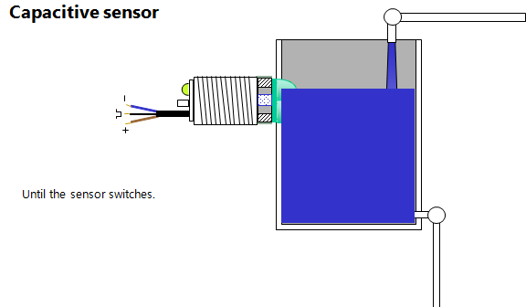

Slide 56
1. | Advantages Detects metal and nonmetal, liquids and solids
2. | Can “see through” certain materials (product boxes)
3. | Solid-state, long life
4. | Many mounting configurations
1. | Disadvantages Short (1 inch or less) sensing distance varies widely according to material being sensed
2. | Very sensitive to environmental factors — humidity in coastal/water climates can affect sensing output
3. | Not at all selective for its target — control of what comes close to the sensor is essential

Slide 57
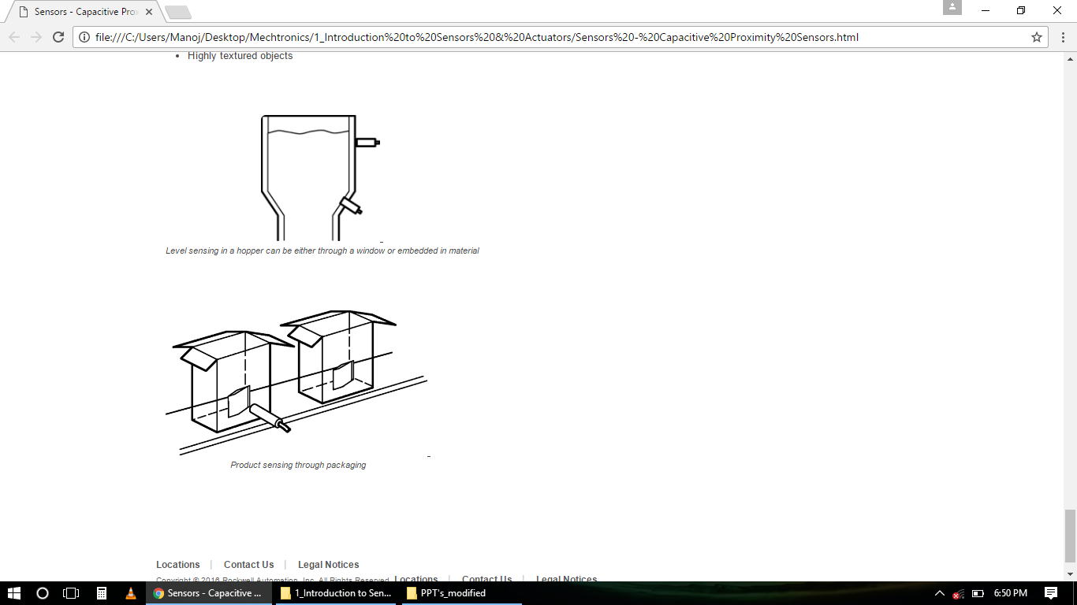
Typical Applications- 1. Liquid level sensing Sensing through a sight glass to watch liquid level, such as batter for food processing or ink for printing applications Insertion through sealed tubes into drums or holding tanks for chemicals or aqueous solutions
2. Product filling lines Bottling applications, such as shampoo Full-case detection to ensure that a container has the required number of products Checking material levels, such as cereal in boxes 3. Plastic parts detection Plastics on product packages, such as spouts on laundry detergent boxes Plastic materials within a hopper
4. Pallet detection for materials handling 5. Irregularly shaped products Objects randomly oriented on conveyor belt Highly textured objects

Slide 58


Motion Sensors- Variable Reluctance
A magnet in the sensor creates a magnetic field
As a ferrous object moves by the sensor, the resulting change in the magnetic flux induces an emf in the pickup coil

Slide 59
Working-
In its simplest form, a VR sensor consists of a coil of wire wound around a permanent-magnet armature.
The target of the sensor is typically a gear or other toothed ring made from ferrous materials.
As the ring rotates in front of the sensor, the teeth concentrate the magnetic flux when they align with the magnetic poles, but let the flux expand outward when the poles are over a gap between the teeth.
The change in flux density created by the change of reluctance at the poles induces an electrical voltage in the coil, creating the output from the sensor.

Slide 60

Reluctance- the ability of a material to pass a magnetic field, and is often likened to resistance in an electrical circuit.
Ferrous materials possess a low reluctance as they help concentrate magnetic fields that easily pass through them.
Mathematically, the equation for reluctance looks much like Ohm’s Law:
where R = value of reluctance,
mmf = magnetomotive force in ampere-turns, and
Φ = intensity of the magnetic field in Webers.
The frequency of the output is controlled by the speed of rotation and the number of teeth in the target.
For example, a 100-tooth gear turning at 1,800 rpm generates an output frequency of 3,000 Hz.

Slide 61



Slide 62


A common method of converting this signal into a useful signal for interfacing with other digital circuit is by using a Schmitt trigger circuit.
• Another method is by using a quenched oscillator circuit as shown in the figure. This circuit has good resistance to interference

Slide 63
Applications
Used to measure speed and/or position of a moving metallic object
A VR sensor used as a simple proximity sensor can determine the position of a mechanical link in a piece of industrial equipment.
A Crankshaft position sensor (in an automobile engine) is used to provide the angular position of the crankshaft to the Engine control unit. The Engine control unit can then calculate engine speed (angular velocity).
The Engine control unit or Transmission control unit (depending on the particular automobile) uses these sensors to determine when to shift from one gear to the next.

Slide 64
Temperature measurement
EMF based
eg- Thermocouple
2.Resistance based
eg- Resistance Temperature Detectors (RTD)

Slide 65

Thermocouples
Based on the Seebeck effect – a phenomenon whereby a voltage that is almost proportional to temperature can be produced from a circuit consisting of two dissimilar metal wires
The junctions at each end of the dissimilar metal wires produce a voltage
One junction is called the hot junction (the junction on the probe) and the other junction is the cold junction (kept at some known reference temperature
The actual difference between the junction voltages is known as Vnet, which is essentially the output voltage of this system.
A thermocouple made from iron and constantan (an alloy) generates a voltage of approximately 35μV/°F

Slide 66

Construction of Thermocouples
At the tip of a grounded junction probe, the thermocouple wires are physically attached to the inside of the probe wall. This results in good heat transfer from the outside, through the probe wall to the thermocouple junction.
In an ungrounded probe, the thermocouple junction is detached from the probe wall. Response time is slower than the grounded style, but the ungrounded offers electrical isolation
The thermocouple in the exposed junction style protrudes out of the tip of the sheath and is exposed to the surrounding environment. This type offers the best response time, but is limited in use to dry, non-corrosive and non-pressurized applications.

Slide 67
Selection of Thermocouples
The following criteria are used in selecting a thermocouple:
Temperature range
Chemical resistance of the thermocouple or sheath material
Abrasion and vibration resistance
Installation requirements (may need to be compatible with existing equipment; existing holes may determine probe diameter)

Slide 68
Types of Thermocouple
• Type B – very poor below 50ºC; reference junction temperature not important since voltage output is about the same from 0 to 42 ºC
• Type E – good for low temperatures since dV/dT is high for low
Temperatures
• Type J – cheap because one wire is iron; high sensitivity but also high uncertainty (iron impurities cause inaccuracy)
• Type T – good accuracy but low max temperature (400 ºC); one lead is copper, making connections easier; watch for heat being conducted
along the copper wire, changing your surface temp
• Type K – popular type since it has decent accuracy and a wide temperature range; some instability (drift) over time
• Type N – most stable over time when exposed to elevated temperatures for long periods

Slide 69


Slide 70
Properties of Thermocouple:
1 The temp and e.m.f relation should be linear and reproducible
2 It should be strong for withstand high temp.
4 It should maintain its calibration without drift for long period of time.
5 Cost should be reasonable
6 It should have long life

Slide 71
Advantages of Thermocouple:
1. Better response
2.Higher range of temperature measurements
3. Sensing element can be easily installed
4. Inexpensive
5.Very convenient for measuring the temp. at one particular point in a piece of appratus.
Disadvantages of Thermocouple:
1. Low accuracy
2. Circuit is very complex
3. For long life they need to be amply protected.

Slide 72


Resistance Temperature Detectors (RTD)
The RTDs use the phenomenon that the resistance of a metal changes with temperature. They are, however, linear over a wide range and most stable.
Typically, a wire (usually a platinum wire) is wrapped around a ceramic or glass rod

Slide 73


Slide 74
Construction of Resistance Temperature Detector or RTD
The construction is typically such that the wire is wound on a form (in a coil) on notched mica cross frame to achieve small size, improving the thermal conductivity to decrease the response time and a high rate of heat transfer is obtained.
In the industrial RTD’s, the coil is protected by a stainless steel sheath or a protective tube. So that, the physical strain is negligible as the wire expands and increase the length of wire with the temperature change.
If the strain on the wire is increasing, then the tension increases. Due to that, the resistance of the wire will change which is undesirable.So, we don’t want to change the resistance of wire by any other unwanted changes except the temperature changes. This is also useful to RTD maintenance while the plant is in operation.
Mica is placed in between the steel sheath and resistance wire for better electrical insulation. Due less strain in resistance wire, it should be carefully wound over mica sheet

Slide 75

The relationship between temperature and resistance of conductors in the temperature range near 0ºC can be calculated from the equation:
Rt=the resistance of the conductor at temperature t (°C)
R₀ = the resistance at the reference temperature, usually 20°C
 = the temperature coefficient of resistance
∆T = the difference between the operating and the reference temperature
Platinum wire has a temperature coefficient of 0.0039 Ω/Ω/°C, which means that the resistance goes up 0.0039 Ω for each ohm of wire for each Celsius degree of temperature rise
Therefore, a 100-platinum RTD has a resistance of 100 Ω at 0°C, and it has a positive temperature coefficient of 0.39 Ω/°C

Slide 76
Advantages of platinum as RTD
The temperature-resistance characteristics of pure platinum are stable over a wide range of temperatures.
It has high resistance to chemical attack and contamination
It forms the most easily reproducible type of temperature transducer with a high degree of accuracy .
It can have accuracy ± 0.01 ºC up to 500 ºC and ± 0.1 ºC up to 1200 ºC.
Linearity over a wide operating range

Slide 77
Limitations of RTD
These are resistive devices, and accordingly they function by passing a current through a sensor.
Even though only a very small current is generally employed, it creates a certain amount of heat and thus can throw off the temperature reading.
This self heating in resistive sensors can be significant when dealing with a still fluid (i.e., one that is neither flowing nor agitated), because there is less carry-off of the heat generated.
This problem does not arise with thermocouples, which are essentially zero-current devices.
Low sensitivity
It can be affected by contact resistance, shock and vibration
No point sensing
Higher cost than other temperature transducers
Requires 3 or 4 wire for its operation and associated instrumentation to eliminate errors due to lead resistance

Slide 78
Applications of Resistance Temperature Detectors
Air conditioning and refrigeration servicing
Food Processing
Stoves and grills
Textile production
Plastics processing
Petrochemical processing
Micro electronics
Air, gas and liquid temperature measurement
Exhaust gas temperature measurement

Slide 79
Comparison

Slide 80

Force/Pressure Sensor

Slide 81

Force/Pressure Sensor
Stress measurement using strain
Strain is change in length (dl) per unit length (l)
Strain gauge is primary sensing element used in pressure, force and position sensors

Slide 82




Slide 83


Strain Gauge
Based on the variation of resistance of a conductor or semiconductor when subjected to a mechanical stress.
The electric resistance of a wire is having length l, cross section A, and resistivity ρ is:
When the wire is stressed longitudinally, R undergoes a change.
Passing small amount of current through such wire will, thus, help measure voltage change.
The sensing element of the strain gauge is made of copper-nickel alloy foil. The alloy foil has a rate of resistance change proportional to strain with a certain constant.

Slide 84

Strain Gauge

Slide 85


Slide 86


Slide 87

Strain Gauge Type
a. Mechanical S G
b. Optical S G
c. Electrical S G
Selection Criterion
Operating Temperature, Nature of Strain, Stability Requirement

Slide 88



Slide 89

Bonded Wire Strain Gauge :
Consists of a strain sensitive conductor (wire) mounted on a small piece of paper or plastic backing.
This gauge is cemented to the surface of the structural member to be tested. The wire grid may be & flat type or wrap-around.
In the flat type after attaching the lead wires to the ends of the grids, a second piece of paper is cemented over the wire as cover.
In the wrap-around type, the wire is wound around a cylindrical core in the form of a close wound helix. This core is then flattened & cemented between layers of paper for the purpose of protection and insulation.
Formerly only wrap-around gauges were
available, but generally flat grid gauges are
preferred as they are superior to wrap-
around gauge in terms of hysterisis, creep,
elevated temperature, performance, stability
& current carrying capacity.

Slide 90

Un-bonded wire strain gauge : The principal is based on the change in electrical resistance of a metallic wire due to the change in the tension of the wire.
This type consists of a stationary frame and a movable platform.
Fine wire loops are wounded around the insulated pins with pretension. Relative motion between the platform and the frame increases the tension in two loops, while decreasing tension in the other two loops.
These four elements are connected approximately to a four arm Wheat stone bridge.
These type strain gauges are used
for measurement of acceleration,
pressure, force etc.

Slide 91


Foil Strain Gauges:
The foil type of strain gauges has a foil grid made up of thin strain sensitive foil.
The width of the foil is very large as compared to the thickness (microns) so that larger area of the gauge is for cementing.
High heat dissipation capability
Better bonding properties

Slide 92


Strain Gauge Circuit
The Wheatstone bridge is an electric circuit for detection of minute resistance changes. It is therefore used to measure resistance changes of a strain gauge.
Strain gauge is connected in place of R4 in the circuit. When the gauge bears strain and initiates a resistance change, ΔR, the bridge outputs a corresponding voltage.

Slide 93


With no force applied to the test specimen, both strain gauges have equal resistance and the bridge circuit is balanced.
However, when a downward force is applied to the free end of the specimen, it will bend downward, stretching gauge #1 and compressing gauge #2

Slide 94



Strain Gauge Circuit

Slide 95
Effect of Temperature on Output of Gauge
Ideally, we would like the resistance of the strain gauge to change only in response to applied strain.
However, strain gauge material, as well as the specimen material to which the gauge is applied, will also respond to changes in temperature.
Strain gauge manufacturers attempt to minimize sensitivity to temperature by processing the gauge material to compensate for the thermal expansion of the specimen material; compensated gauges reduce the thermal sensitivity, they do not totally remove it.

Slide 96

Temperature compensation
By using two gauges
One gauge is active, and a second gauge is placed transverse to the applied strain.
The strain has little effect on the second gauge, called the dummy gauge.
Because the temperature changes are identical in the two gauges, the ratio of their resistance does not change, the voltage does not change, and the effects of the temperature change are minimized.

Slide 97
Electromagnetic Flow sensor
Magnetic flow meters operate based upon Faraday's Law of electromagnetic induction, which states that a voltage will be induced in a conductor moving through a magnetic field.
Faraday's Law: E = k B D V
The magnitude of the induced voltage E is directly proportional to the velocity of the conductor V, conductor width D, and the strength of the magnetic field B.
Magnetic field coils are placed on opposite sides a pipe to generate a magnetic field.

Slide 98


Electromagnetic Flow sensor
As the liquid moves through the field with average velocity V, electrodes sense the induced voltage.
An insulating liner prevents the signal from shorting to the pipe wall.
The output voltage E is directly proportional to liquid velocity, resulting in the linear output of a magnetic flow meter.

Slide 99


Slide 100

Disadvantages-
Operating cost is high particularly if heavy slurries are handled
Must be full at all times because velocity as analogues to volume flow rate
Limited to fluid having conductivity at least of order of 0.05μmho/cm
Applications

Slide 101
Actuator Types
converts an information signal from the control, into energy acting on the basic system.
FORCE / MOVEMENT
ACOUSTIC
OPTICAL
HEAT
ELECTRICAL AND MAGNETIC

Slide 102

Actuators

Slide 103


Stepper Motor
Discrete Positioning device
Moves one step at a time for each input
Appropriate excitation in winding/s, makes the rotor attract towards the stator

Slide 104

Stepper Motor

Slide 105
Advantages
The rotation angle of the motor is proportional to the input pulse.
The motor has full torque at standstill (if the windings are energized)
Precise positioning and repeatability of movement since good stepper motors have an accuracy of 3 – 5% of a step and this error is non cumulative from one step to the next.
Excellent response to starting/stopping/reversing.
Very reliable since there are no contact brushes in the motor. Therefore the life of the motor is simply dependant on the life of the bearing.
The motors response to digital input pulses provides open-loop control, making the motor simpler and less costly to control.
It is possible to achieve very low speed synchronous rotation with a load that is directly coupled to the shaft.
A wide range of rotational speeds can be realized as the speed is proportional to the frequency of the input pulses.
Disadvantages
Resonances can occur if not properly controlled.
Not easy to operate at extremely high speeds.

Slide 106
Servo Motor
Precise control of angular position, velocity and acceleration
Electric (DC/AC) motor driven using Pulse Width Modulation (PWM)
Closed looped control system
Basically DC motor (in some special cases it is AC motor)
Servo unit consists - small DC motor, potentiometer, gear arrangement, an intelligent circuitry

Slide 107

Servo Motor
Servo mechanism consists of position sensor (potentiometer/encoder), gear mechanism and intelligent circuitry

Slide 108
Advantages:
If a heavy load is placed on the motor, the driver will increase the current to the motor coil as it attempts to rotate the motor. Basically, there is no out-of-step condition.
High-speed operation is possible.
Disadvantages:
Since the servomotor tries to rotate according to the command pulses, but lags behind, it is not suitable for precision control of rotation.
Higher cost.
When stopped, the motor’s rotor continues to move back and forth one pulse, so that it is not suitable if you need to prevent vibration

Slide 109
Applications of Servo Motors
In Industries they are used in machine tools, packaging, factory automation, material handling, printing converting, assembly lines, and many other demanding applications robotics, CNC machinery or automated manufacturing.
They are also used in radio controlled airplanes to control the positioning and movement of elevators.
They are used in robots because of their smooth switching on and off and accurate positioning.
They are also used by aerospace industry to maintain hydraulic fluid in their hydraulic systems.
They are used in many radio controlled toys.
They are used in electronic devices such as DVDs or Blue ray Disc players to extend or replay the disc trays.
They are also being used in automobiles to maintain the speed of vehicles.

Slide 110


Solenoid Actuator
Electromagnetic actuator
Consist of a movable ferrite core that is activated by current flow
When the coil is energized, a magnetic field is established that provides the force to push or pull the core
Provide large force over a short duration
Normally used as linear actuator
Application in- Room heating, gas flow, water flow etc

Slide 111
Working-
A solenoid is defined as a coil of wire commonly in the form of a long cylinder that when carrying a current resembles a bar magnet so that a moveable core (armature) is drawn into (pulled-in) the coil when a current flows.
A more simple definition is that a solenoid is a coil and a moveable iron core used to convert electrical energy into mechanical energy.
Normally, the movement of the core compresses a spring.
On power-off, the armature returns back to its normal
The stroke of the armature varies from fraction of a mm to several mm depending on application.
There are two main categories of solenoids:
Rotary – rotary motion of the armature
Linear – linear motion of the armature

